Slide 1

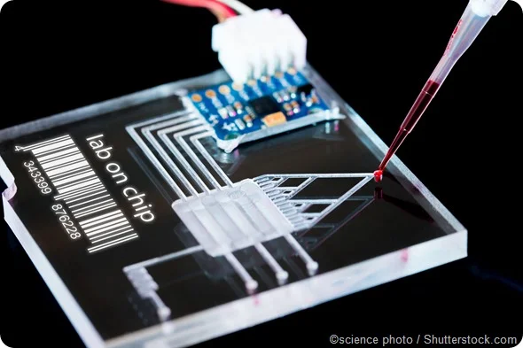

Team 78: Interdigitated Electrodes in Microfluidics
Bi-Weekly Update 4 Erin Ingram and Omar Mahmood Sponsor: Dr. Arum Han, Dr. Han Zhang TA: Dalton Cyr
Notes:
Omar

Slide 2
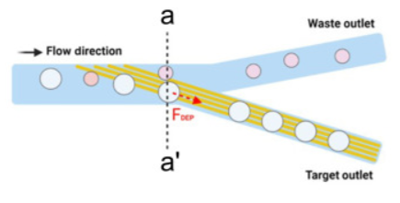
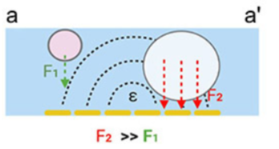
Project Summary
Mitigating satellite droplets in microfluidic “lab-on-a-chip” devices that lead to false test results in drug screenings, disease diagnostics, DNA analysis applications
Using interdigitated electrodes (IDEs) to perform size-based filtration on microfluidic droplets
Notes:
Omar

Slide 3
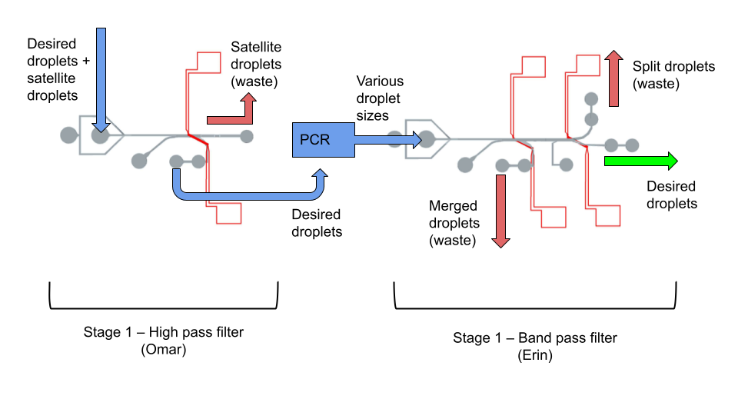
Project/Subsystem Overview
Diagram showing subsystems – with labels showing subsystem owners
Bullets giving essential system/subsystem characteristics
If major changes in subsystems, show before and after … see next slide
Notes:
both

Slide 4
Project Timeline
Fabrication
Preliminary Validation
Experiments & statistical analysis
Component Optimization
Validation of whole device
High level figure showing where you are at in the project, what’s completed, what’s underway – it should take about 30 seconds to summarize where you are in the timeline
-- Save discussion for subsystem update
-- Save detail for execution plan & validation plan status
Fabricated High Pass Filter
Fabricated Band Pass Filter
Fabricated IDE’s
No leakages or blockages
High Pass filter sorts within acceptable range
Band Pass filter sorts within acceptable range
Test different voltages
Test different IDE parameters
Use image processing software
Refabricate IDE’s if needed
Design new channels if needed
Decide on IDE parameters
Run whole system together
Test droplet maneuverability between filters
Notes:
erin

Slide 5
Experimentation
Omar
Accomplishments since last presentation 18 hrs of effort | Ongoing progress/problems and plans until the next presentation
Conducted experiment to determine the threshold voltages needed to sort 5 different sized droplets Fabricated channel-ide slides Second thesis installment | Run phase 2 of experiments -Testing different IDE parameters Fabricate more channel-ide slides
Notes:
omar

Slide 6
Experimentation
Generated droplets of 5 different sizes
90 µm
100 µm
120 µm
140 µm
160 µm
Increased voltage to determine the threshold voltage needed to sort the droplets

Slide 7
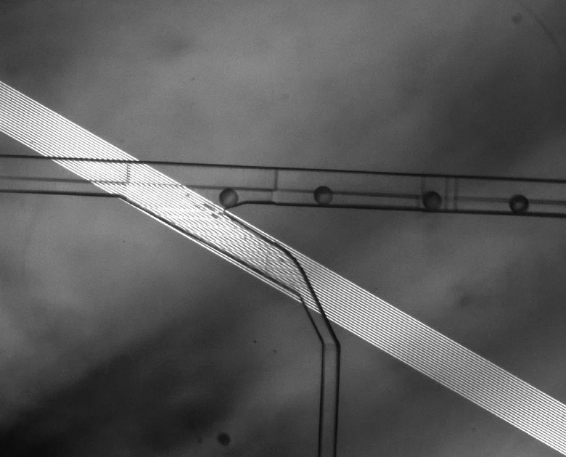
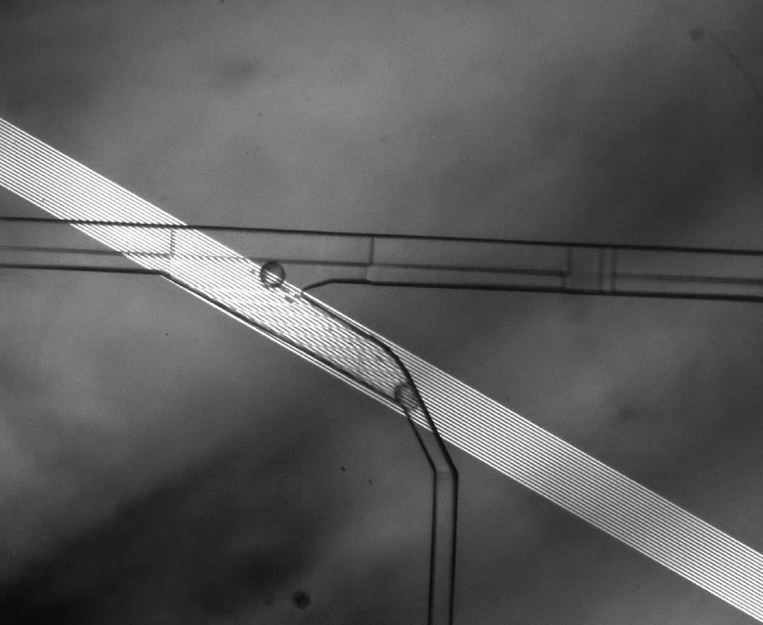
Results
IDE off
Droplet Diameter (µm) | Threshold Voltage Trial 1 (mV) | Threshold Voltage Trial 2 (mv)
90 | 90 | 85
100 | 120 | 125
120 | 150 | X
140 | X | 160
160 | 190 | 200
IDE on

Slide 8
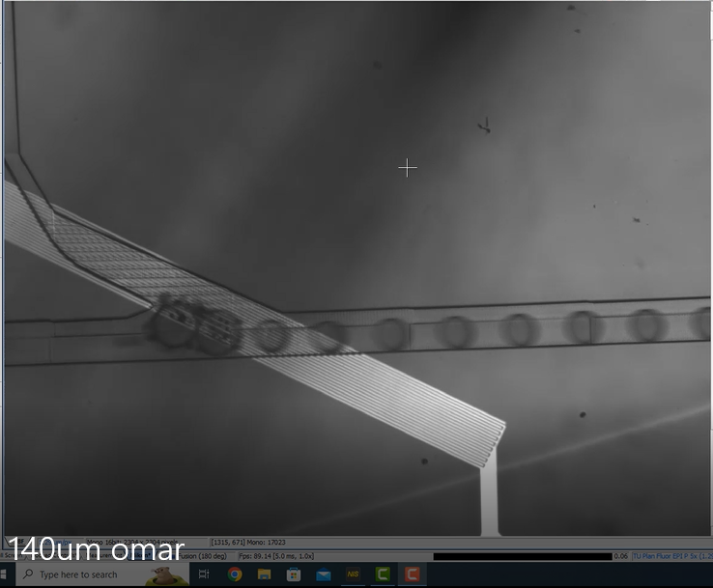
IDE burning up
Experimented and saw that IDE burned up after prolonged periods of time with 200mV + voltage
Burnt IDE led to droplets merging and air bubbles forming instead of sorting

Slide 9

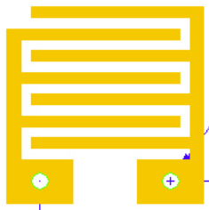
Experimental Plan
IDE size/spacing
Simpler experimental plan
Test filtration using 5um, 10um, 20um IDEs
Hold voltage constant at 0.15 V
Notes:
omar

Slide 10
Subsystem 2: Band Pass Filter
Erin
Accomplishments since last update: 10 hours of effort | Plan for next 2 weeks:
Cleanroom trainings: Gowning training Safety training EVG 610 Mask Aligner training BIDTEC Spin Coater training Second thesis installment | Cleanroom check-off trainings (tomorrow) Fabricate IDEs for Omar to use in experiments 5μm, 10μm, 20μm Revise & edit thesis
Notes:
erin

Slide 11
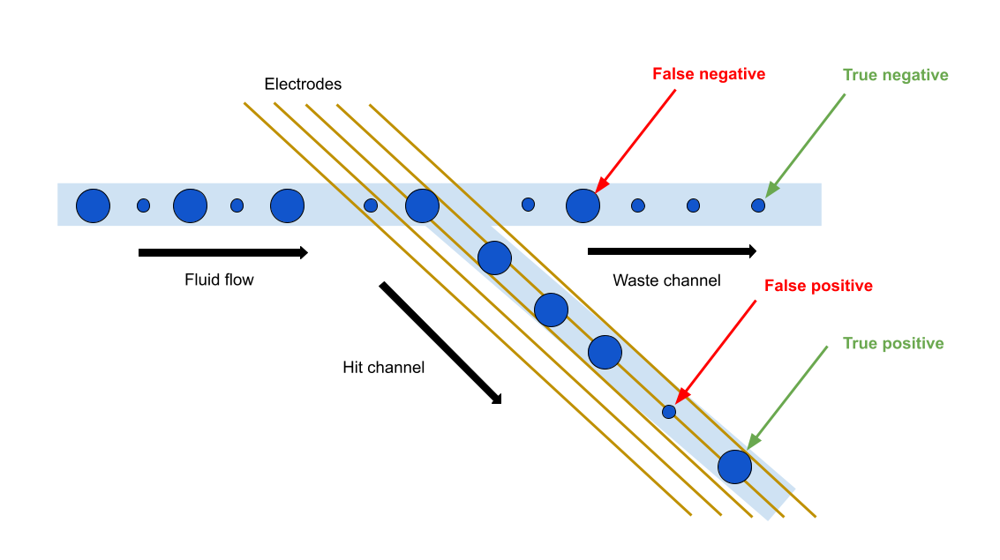
Results definitions

Slide 12
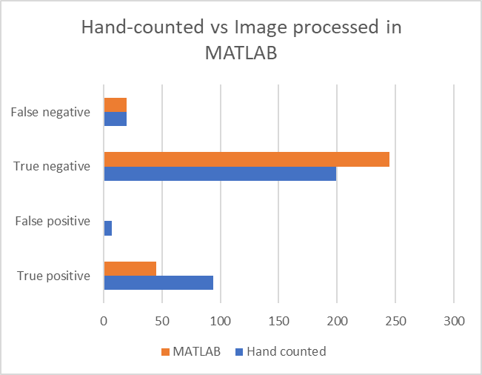
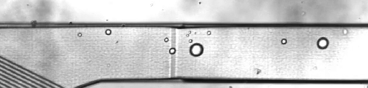
Image Processing Results
Experiment:
High-pass filter
IDE: 10 µm
Applied Voltage: 0.7V, 5 kHz sine wave
Results:
False neg - doing well
True neg - overcounting
May actually be more accurate than hand-counted
False pos - similar
True pos - undercounting
Overall, matches hand-counted results to about 67%

Slide 13
Execution Plan
Date | Accomplishment
February 22 | Complete image processing on our previous experiments At least one experiment
March 8 | Continue experiments
March 22 | Continue experiments
April 5 | Image analysis on all experiments Thesis final installment
April 19 | Finalize optimal device design
May 3 | Validation of entire system
Notes:
erin

Slide 14
Validation Plan
Things we need to do: | Progress | Subsystem
Image processing on preliminary validation experiments |  | Both
Voltage experiment: 0.7V |  | Both
Voltage vs Flow Rate experiments |  | Both
Droplet size vs Threshold voltage experiments |  | Both
IDE experiment: 5um |  | Both
IDE experiment: 10um |  | Both
IDE experiment: 20um |  | Both
Image processing on all voltage and IDE experiments |  | Both
Determine best voltage & IDE combo |  | Both
Final experiments with best parameters |  | Both
Notes:
erin

Slide 15
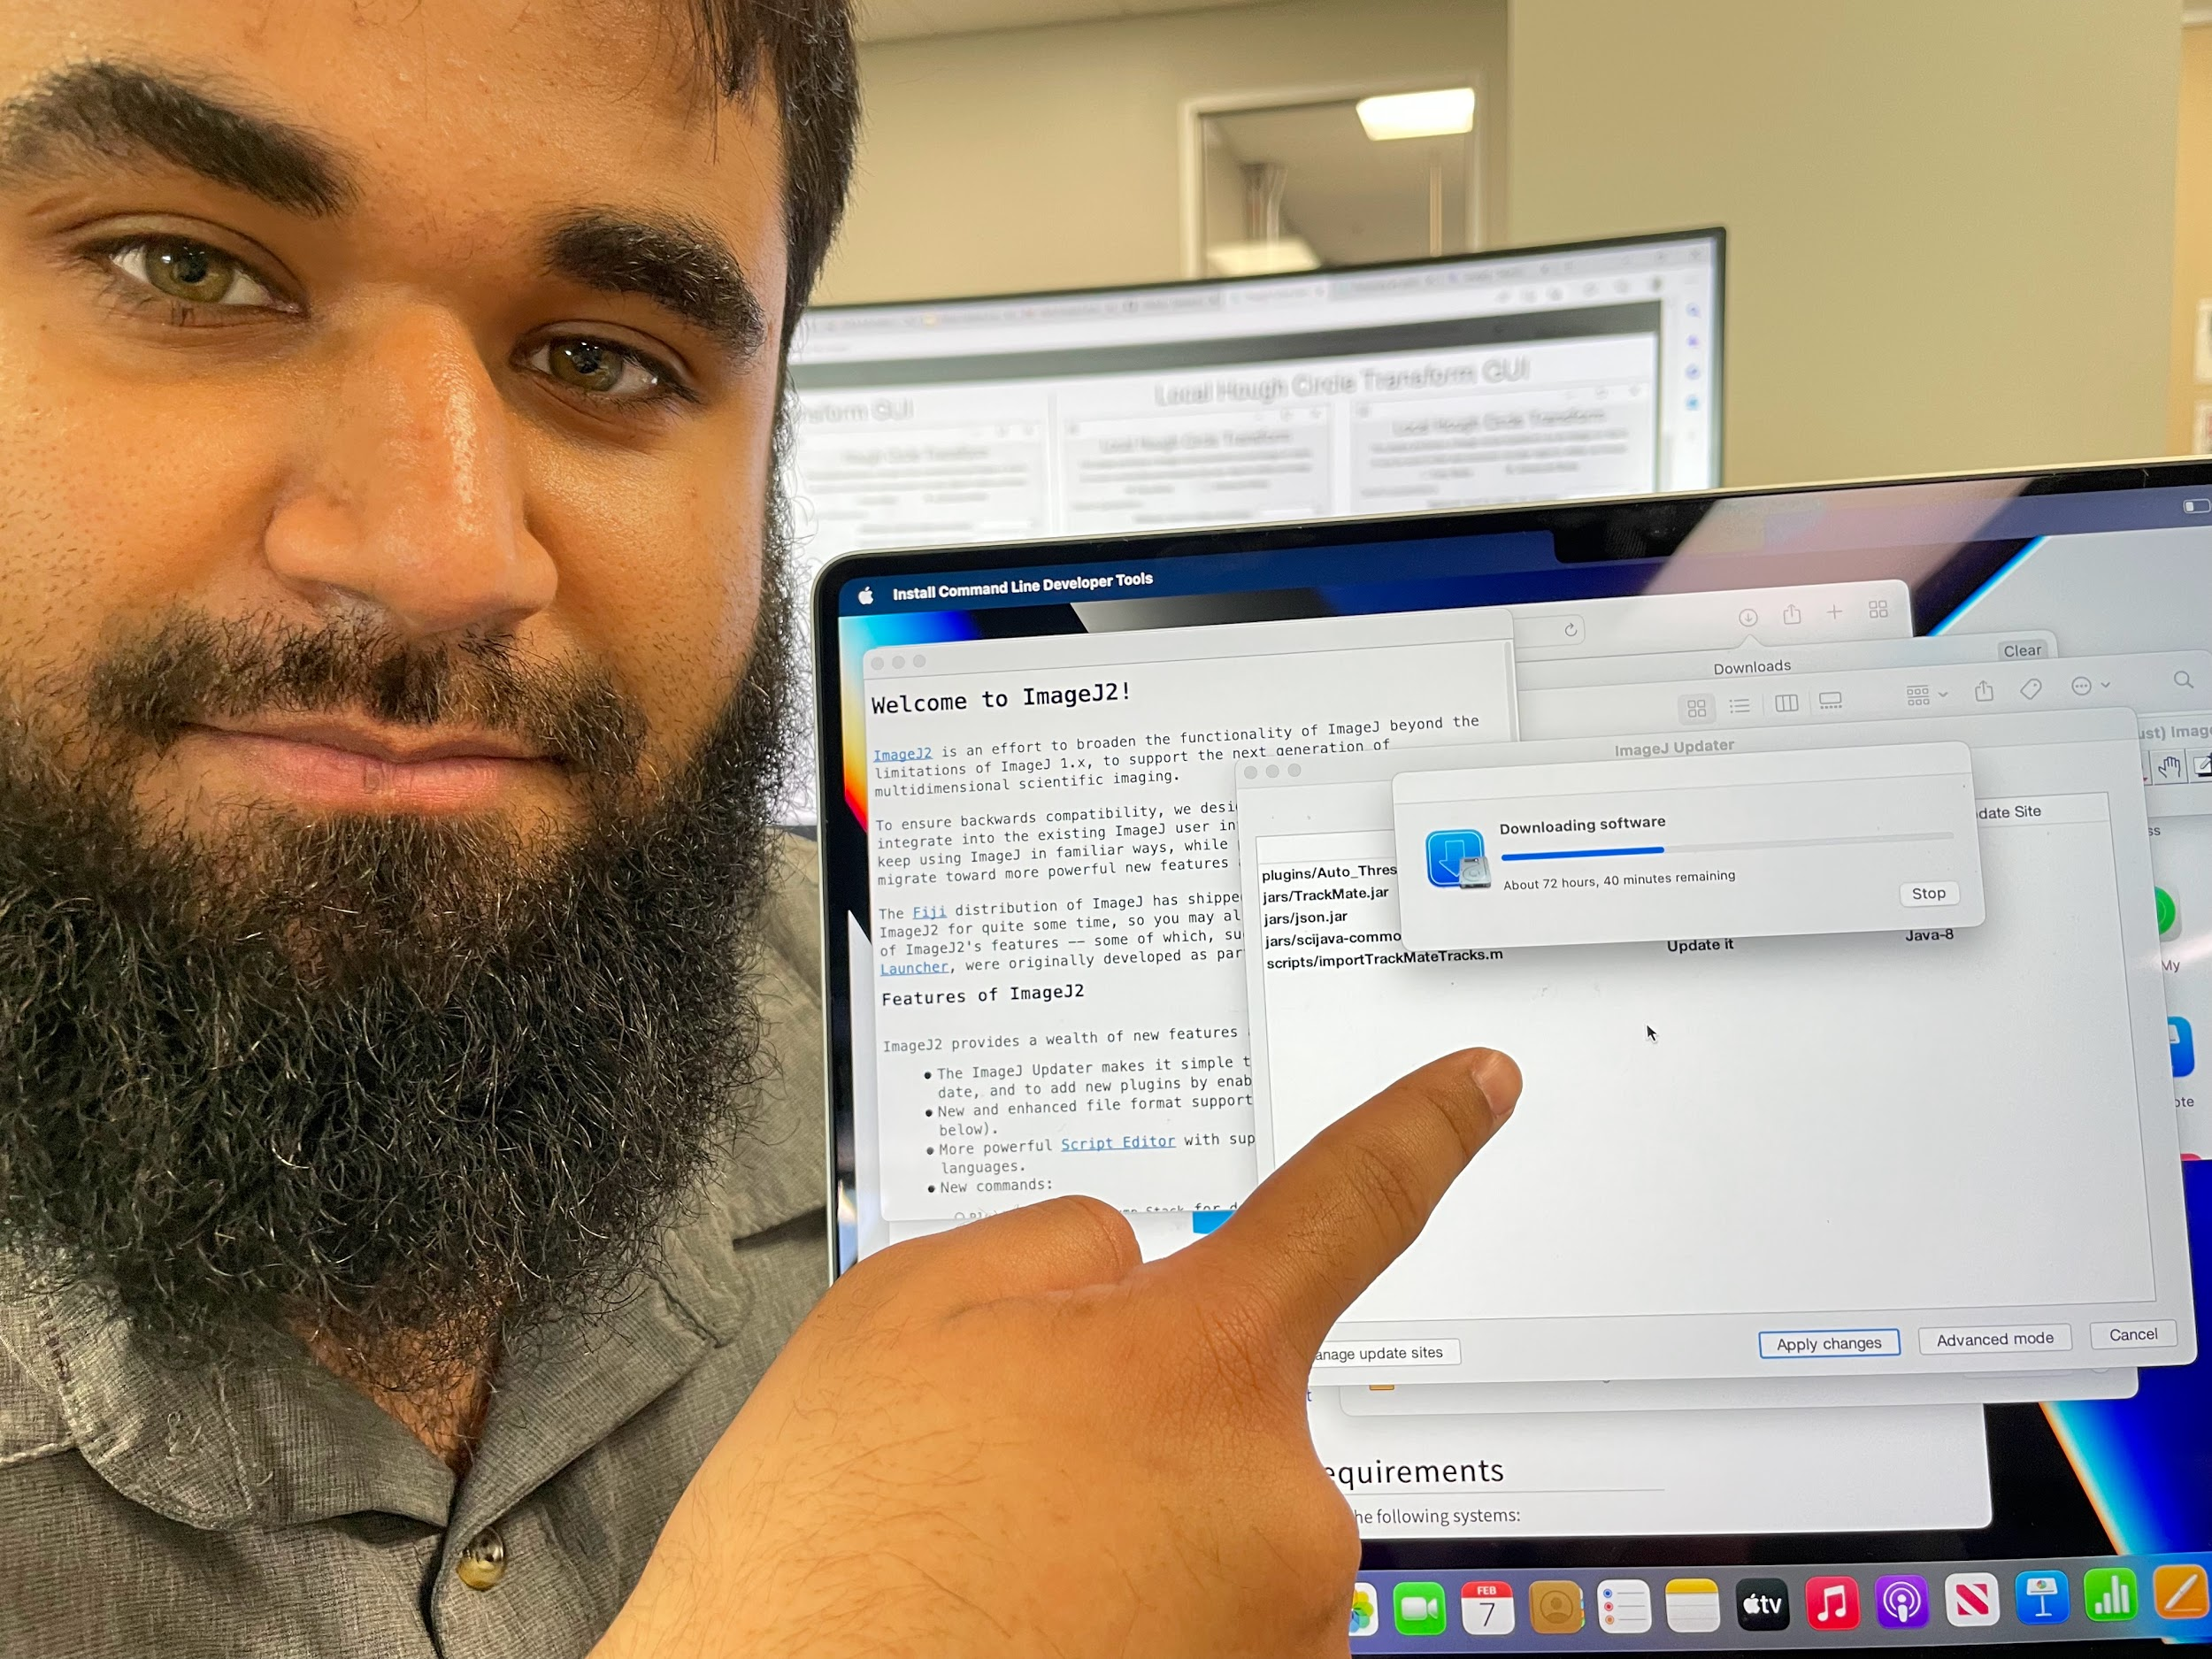
Thank you!
Questions?

